Slide 1


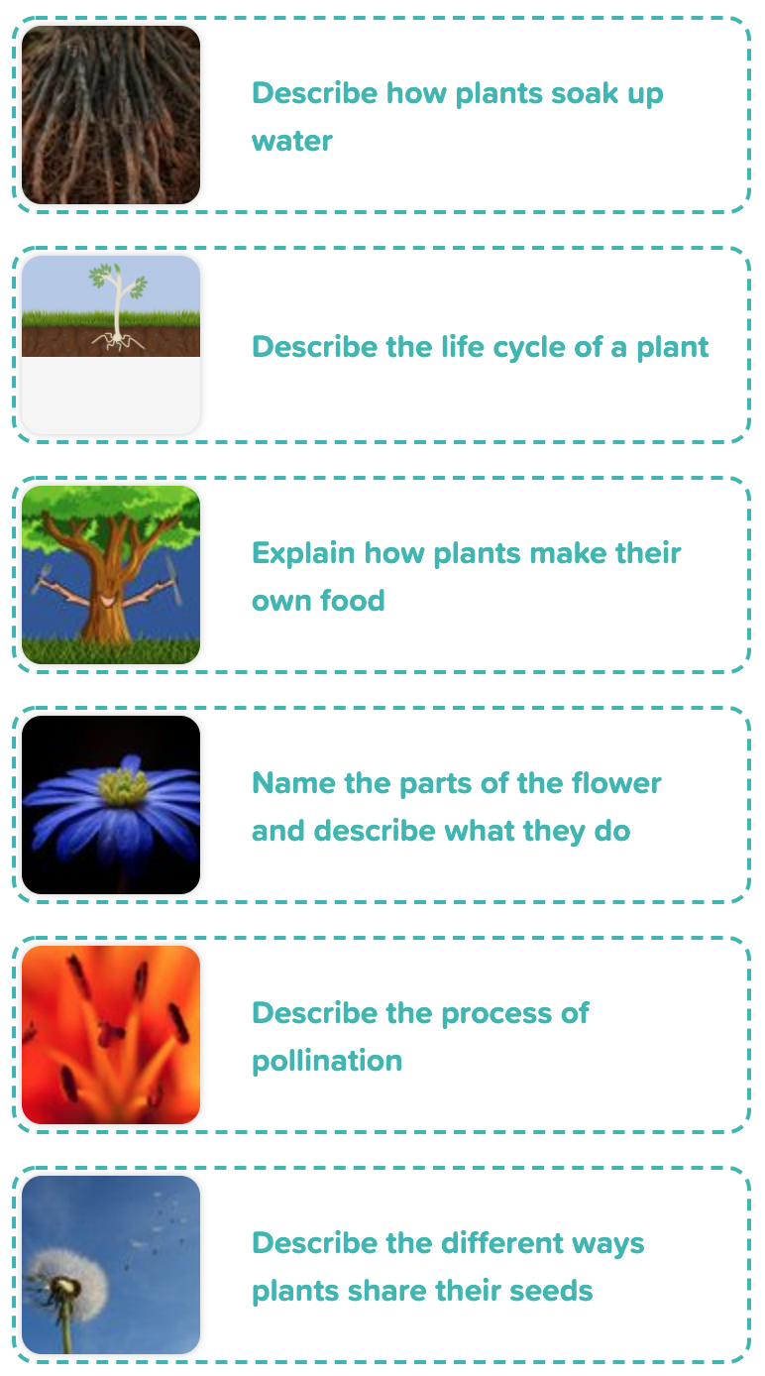
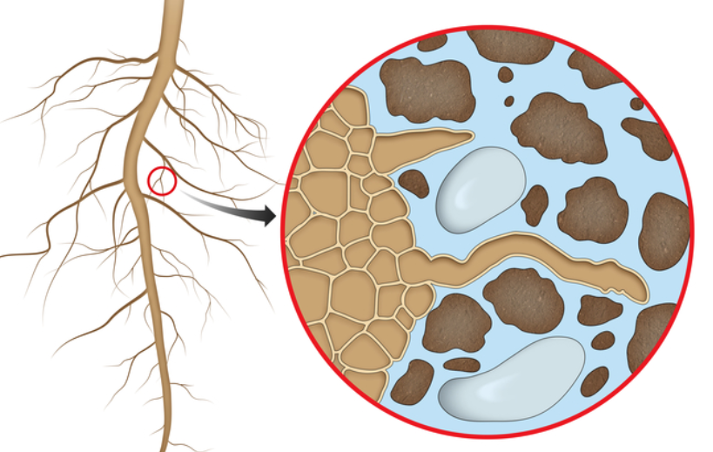
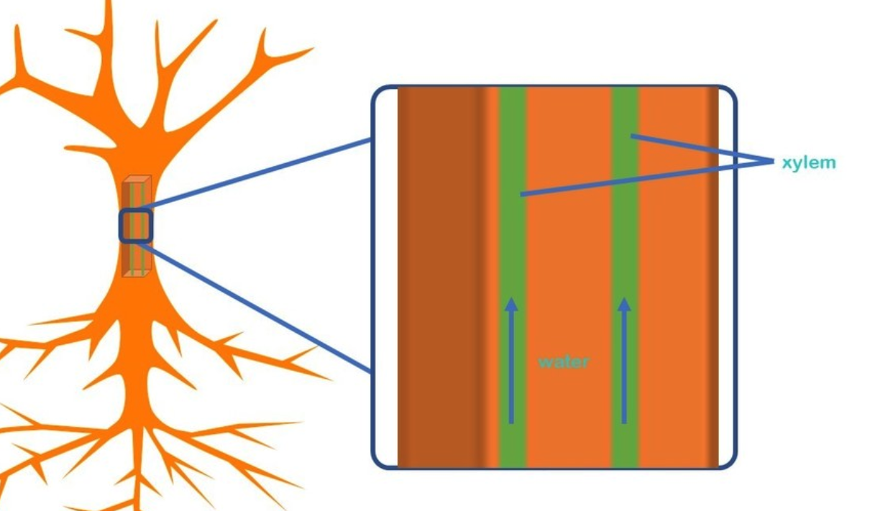
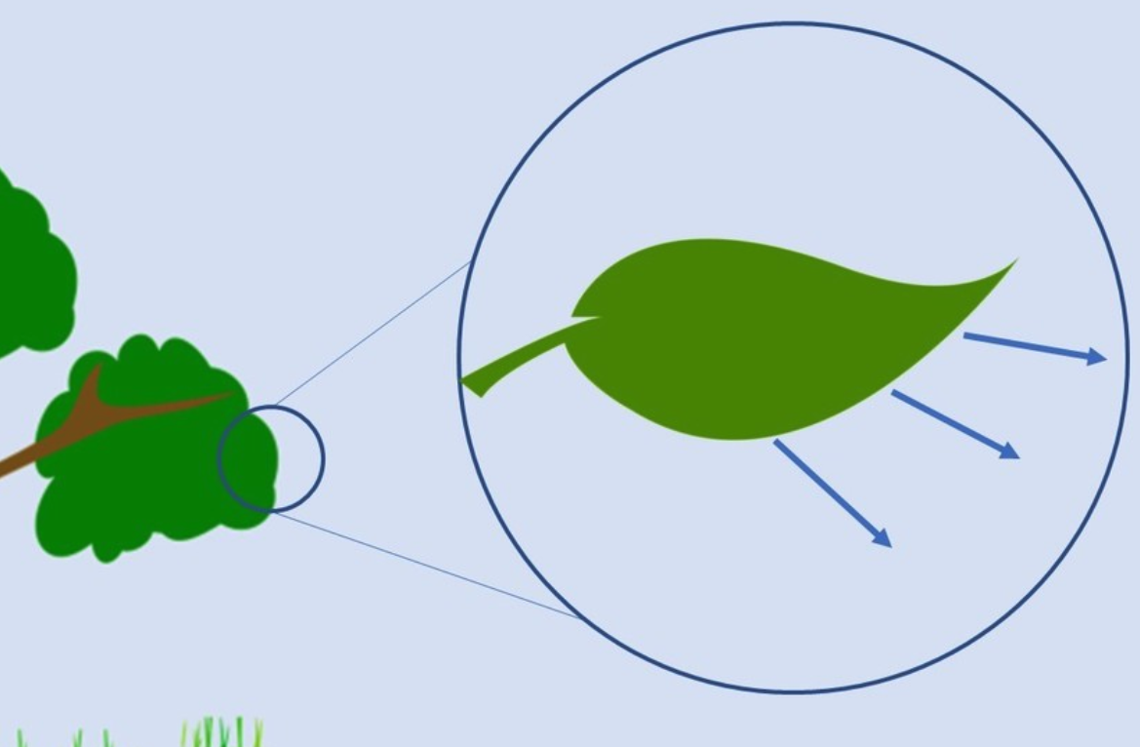
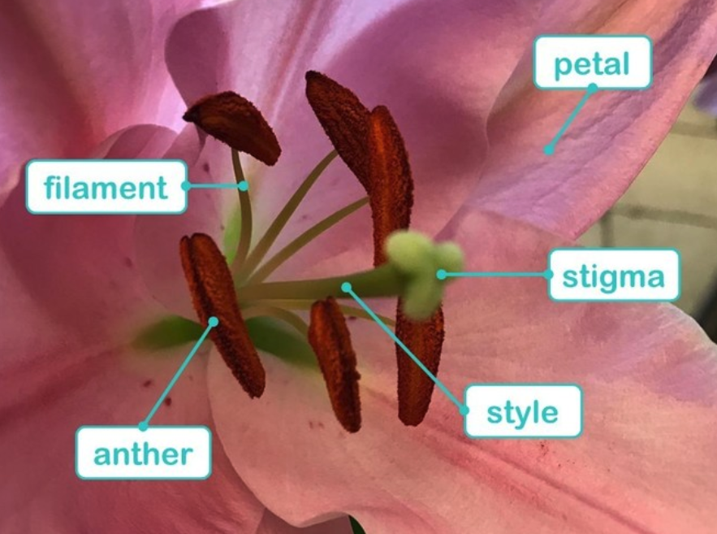
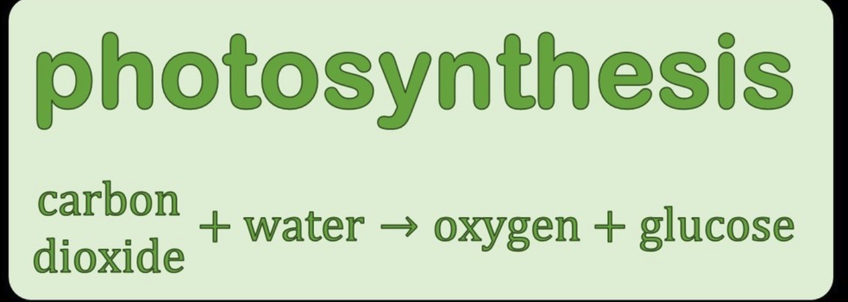
God shines within our hearts. Jesus walks by our side. The Holy Spirit gives us strength.
Science - Biology
Plants – Life Cycles
ROCKET WORDS Learn these words and their definitions.
Key Word | Definition
transpiration | Water escaping through plant leaves.
photosynthesis | The chemical reaction in plants that allows them to make their own food
carbon dioxide | A colourless, odourless gas, it is taken in by plants.
pollination | The process of moving pollen from one flower to another.
dispersal | The spreading of a plant’s seeds over a wide area.
xylem | A tube that transports water from the roots, through the stems, to the leaves.
phloem | A tube that transports food and nutrients from the roots, through the stem, to the leaves.
glucose | A sugar made during photosynthesis.
Composites
Diagrams and Pictures - What do I need to know?
ROOT HAIRS
These are tiny strands on roots which absorb the water and nutrients from the soil.
XYLEM and PHLOEM
This diagram shows how the phloem work. They are a bit like veins – they go right from the roots, through the stem, to leaves. They transport water. Phloem are similar, but they move the food and nutrients.
TRANSPIRATION
Water escapes from the leaves, which forces the plant to suck more water up via the xylem to replace what it has lost.
PARTS OF A FLOWER
All these parts are vital. The petal is bright and pretty to attract insects. The anther makes pollen and is held up by the filament. The stigma is sticky to stop the pollen dropping, and this sits on a tall style to make sure the insect can find it!

