Slide 1
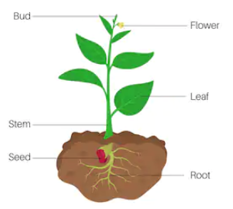

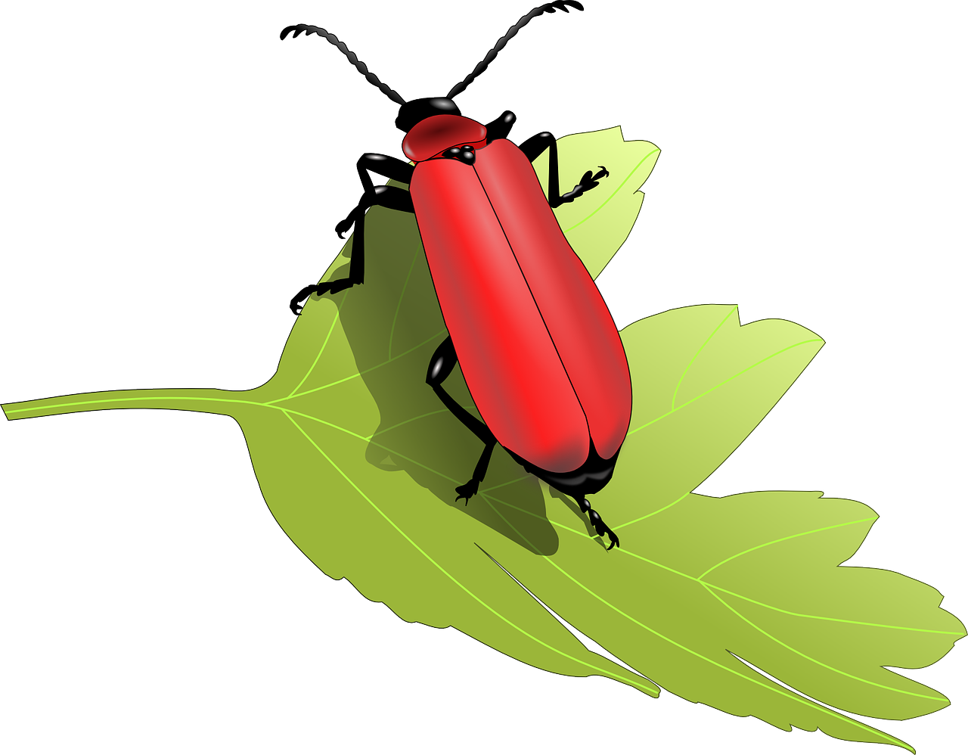

Knowledge Organiser KS1
Science: Biology Plants
Farmers can farm both animals and crops.
There are different kinds of farm for different produce i.e. dairy, grain, citrus.
Land used for crop farming is called ‘arable.’
Mastery components
Composites
GR8! – 8 words and meanings to learn
Key Word | Meaning
1. seed | A small round or oval object produced by a plant.
2. root | The part of a plant that grows down into the earth to get water and food.
3. flower | The blossom of a plant.
4. stem | Stick-like central part of a plant that grows above the ground from which leaves grow.
5. crop | The name given to vegetable, cereal or grain that is grown to sell.
6. leaf | The flat, green part of a plant joined at one end to the stem.
7. fruit | Made by plants and usually come from flowers, we eat fruit and they are healthy.
8. grain | Wheat or other cereal grown to be used as food.
bud
Lesson 1
Understand what a plant needs in order to grow
Lesson 2
Know the basic parts of a plant
Lesson 3
Identify and describe the basic structure of a variety of flowering plants and trees
Know how plants change of time
Understand the difference between an evergreen and deciduous tree
Know about different sources of food grown by farmers
Lesson 4
Lesson 5
Lesson 6
flower
leaf
stem
seed
root
Seeds are moved by insects or the wind.
Plants need water, light, space and nutrients to grow.
You can tell how old a tree is by the amount of rings inside it.

Slide 2
Before and After…
Question 1: If you are caring for a plant, which of these should you do? | Start of unit: | End of unit:
Put your plant in a fridge
Water your plant regularly
Put it in a cupboard
Cut the leaves off
Remove all flowers
Question 4: Match these words to the description: | Start of unit: | End of unit:
deciduous coniferous
A tree that looses its leaves in the autumn every year
A tree that has leaves all year round
Question 2: To grow a plant, you must first place a _____ in soil. | Start of unit: | End of unit:
seed
flower
petal
stem
thistle
rod
Question 5: Match these words to the correct description | Start of unit: | End of unit:
wild garden
A piece of land that is part of a house where plants, trees and vegetables can grow
Question 3: Answer yes or not. A plants needs: | Start of unit: | End of unit:
water
sunlight
soil
garden
pot
Animals and plants that are not looked after by people

