Slide 1




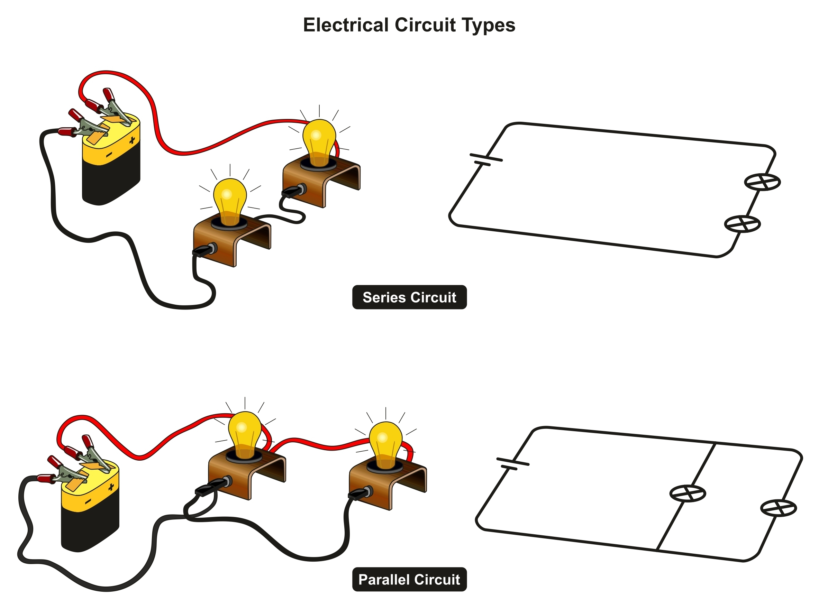
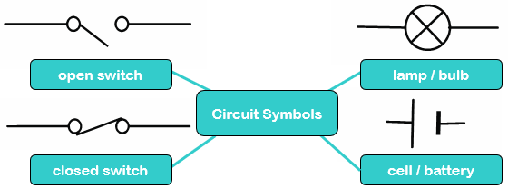

Science: Physics
Unit: Electricity
ROCKET WORDS Learn these words and their definitions.
Key Word | Definition
series circuit | A looped circuit where the electricity flows from the positive to negative terminal of the battery.
circuit diagram | Electrical components shown in a picture by using standard symbols.
parallel circuit | A circuit with two or more pathways for the current to flow through.
conductor | Materials which allow electricity to flow through them with ease.
insulator | Materials that do not allow electricity to pass through them with ease.
loop | A complete circuit.
switch | A toggle which is changed by someone as way of controlling an electrical circuit or system.
resistance | A measure of how much an object opposes the flow of electrons.
It is very important to be safe with electricity. Electricians are trained to be safe with electrical circuits and equipment.
Composites
All metals are good conductors of electricity and materials like rubber are good insulators.
To know how to work safely with electricity.
To know how electricity is transported through a circuit.
To know the basic parts of a circuit.
I know the component parts of a series circuit.
I know common conductors and insulators.
I know the difference between a series and a parallel circuit.
A series circuit
We can conserve energy by:
Turning off electrical devices
Turning lights off
Using renewable sources such as solar and wind power
Using energy-saving lightbulbs
God shines within our hearts. Jesus walks by our side. The Holy Spirit gives us strength.

